Slide 1
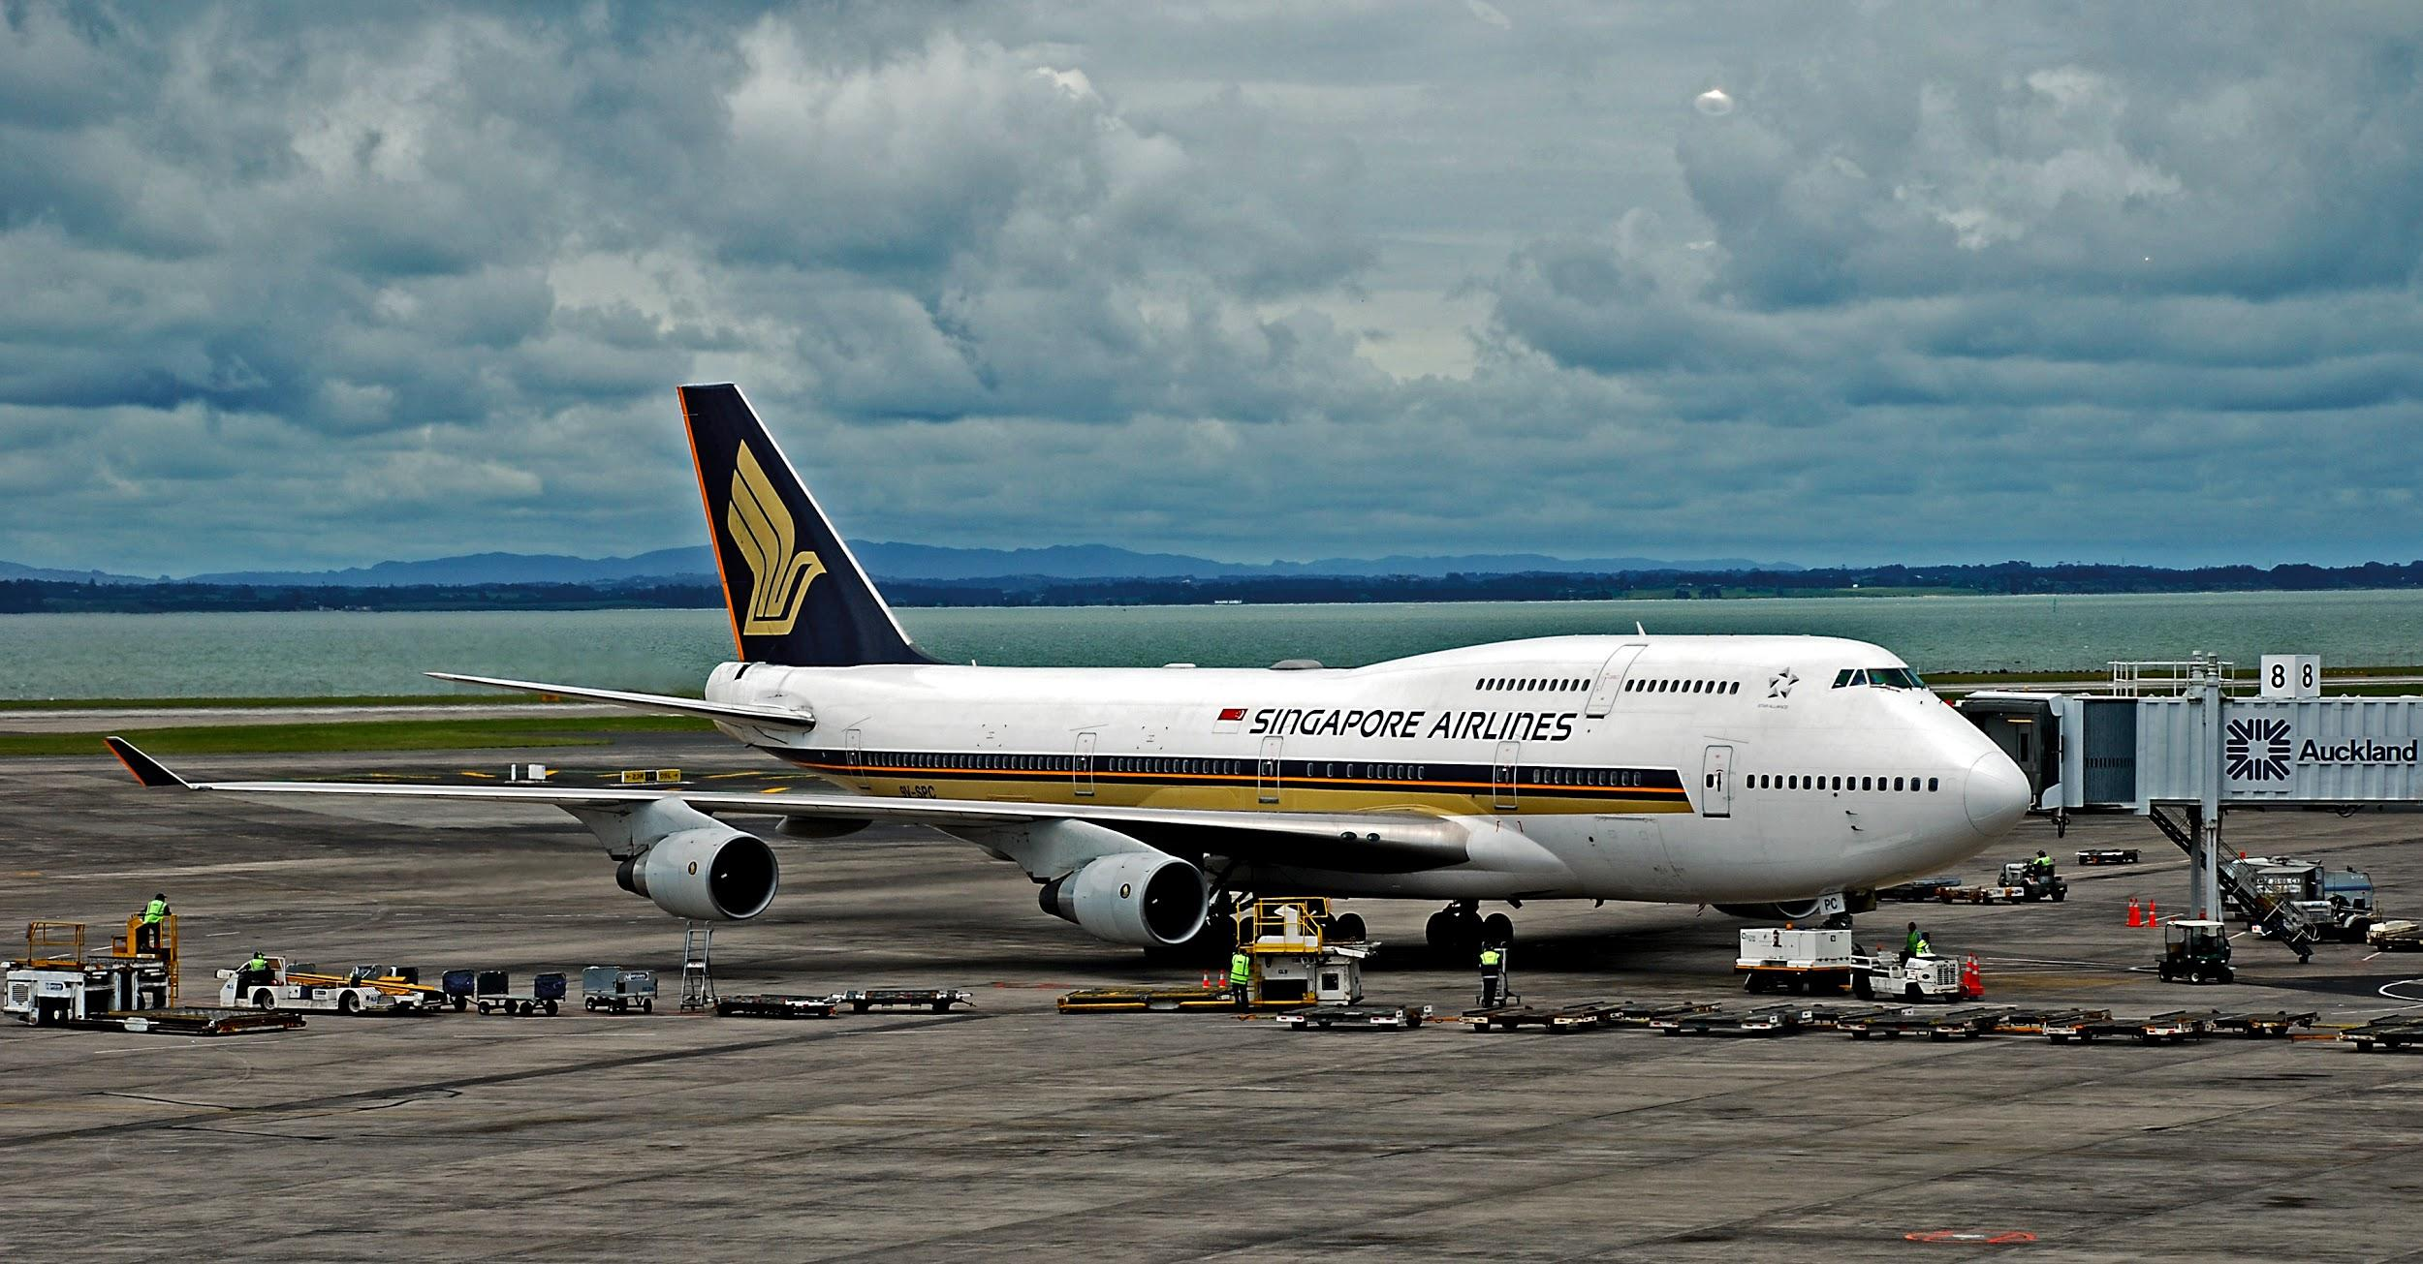
Singapore Airlines App Challenge 2016
By Team JavaChip

Slide 2
This Proposal Contains The Following:
1. Design Process - What makes a seamless travel experience?
2. Introducing App: My Journey
2.1 Solution 1: Smart Dash-Board
2.2 Solution 2: Real-Time Flight Updates
2.3 Solution 3: Seamless Airport Navigation
3. Business Value For SIA
4. Team Bio

Slide 3
1.Design Process
Notes:
Usually, a disruption means having to manually check the board for flight information and seek out customer service for assistance. With ‘My Journey’, the app can be linked up with SIA’s new Sabre crew management system to relay information during disruptions. For example, SIA can consider adding a built in chat feature in order to provide remote, customer service for consumers. This can make a big difference in fast-changing environments where incidents like disruptions or schedule changes require crew to act decisively and efficiently.
Once implemented, Singapore Airlines, SilkAir and Singapore Airlines Cargo will be able to quickly and efficiently manage and track all customer operations, from a single, integrated and real-time web platform, eliminating the work of multiple systems. Using ‘My Journey’, crew managers can plan, schedule, track and manage disruptions to rosters, and impact to crew accommodation. This enables more responsive decision-making and improved productivity and efficiency, including quicker staffing solutions to alleviate flight delays. It will also improve the airlines’ planning capabilities to help meet training and qualification requirements, as mandated by regulatory authorities.
Built around streamlined workflows to make crew management easy and efficient, Crew Manager has an intuitive user interface and includes customizable rules for greater airline control and flexibility. The Crew Manager crew portal and services-based architecture also offer web and mobile browser connectivity for crew members with self-service tools for interactive roster management.

Slide 4
Our Understanding Of SIA And The Challenge
SIA’s Mission is to be a global company dedicated to providing air transportation services of the highest quality and to maximize returns for the benefit of its shareholders and employees
SIA’s four main passenger profiles are: Global Executives, Premium Leisure, Millennials and Experience Seekers, each with both overlapping and similar needs
How might we design an app that is aligned with SIA’s strategy of cost-efficient, customer excellence?

Slide 5
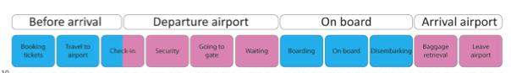
Creating A Seamless Travel Experience
Our main focus for this app was on creating an experience of seamless, premium travel because we feel that this is at the core of why passengers choose SIA in the first place
So what makes a travel experience seamless?
To answer that, we broke down the entire passengers journey into every sub-stage to examine which areas could be better improved on based on our personal flight experiences.

Slide 6
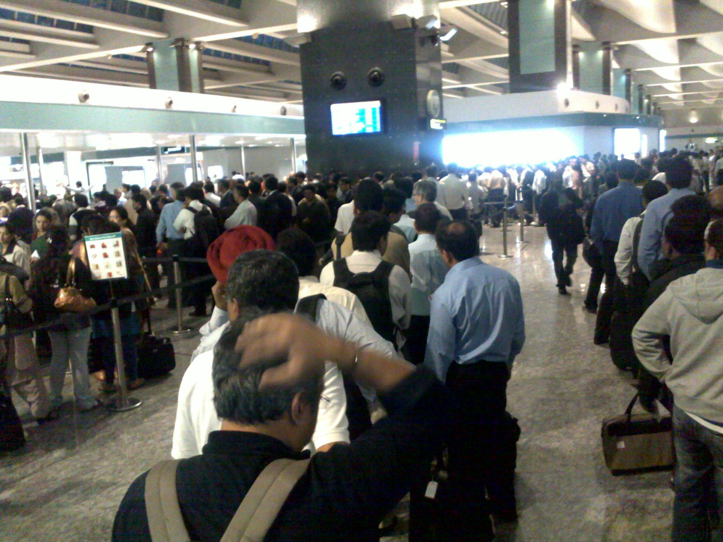

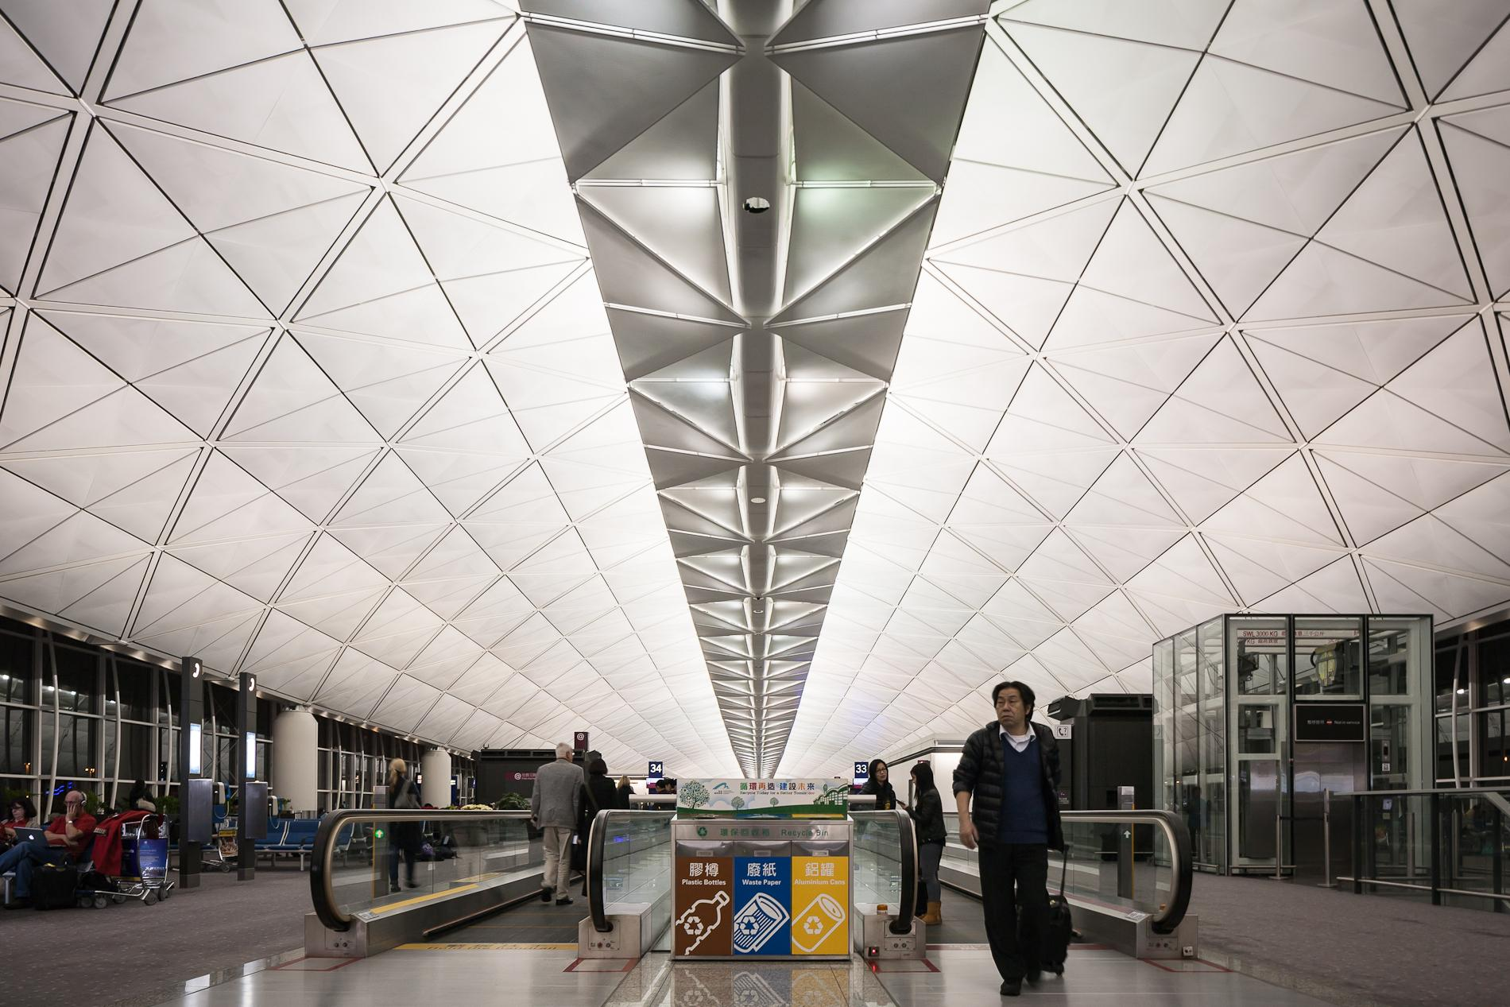
We Uncovered Some Universal Passenger Challenges That Would Hinder A Seamless Travel Experience:
Travel inefficiences and hiccups due to lack of real-time flight information
Existing travel information is messy and hard to consolidate
Hard to navigate around different airports due to lack of maps availability

Slide 7
2.My Journey App Features
Notes:
Usually, a disruption means having to manually check the board for flight information and seek out customer service for assistance. With ‘My Journey’, the app can be linked up with SIA’s new Sabre crew management system to relay information during disruptions. For example, SIA can consider adding a built in chat feature in order to provide remote, customer service for consumers. This can make a big difference in fast-changing environments where incidents like disruptions or schedule changes require crew to act decisively and efficiently.
Once implemented, Singapore Airlines, SilkAir and Singapore Airlines Cargo will be able to quickly and efficiently manage and track all customer operations, from a single, integrated and real-time web platform, eliminating the work of multiple systems. Using ‘My Journey’, crew managers can plan, schedule, track and manage disruptions to rosters, and impact to crew accommodation. This enables more responsive decision-making and improved productivity and efficiency, including quicker staffing solutions to alleviate flight delays. It will also improve the airlines’ planning capabilities to help meet training and qualification requirements, as mandated by regulatory authorities.
Built around streamlined workflows to make crew management easy and efficient, Crew Manager has an intuitive user interface and includes customizable rules for greater airline control and flexibility. The Crew Manager crew portal and services-based architecture also offer web and mobile browser connectivity for crew members with self-service tools for interactive roster management.

Slide 8
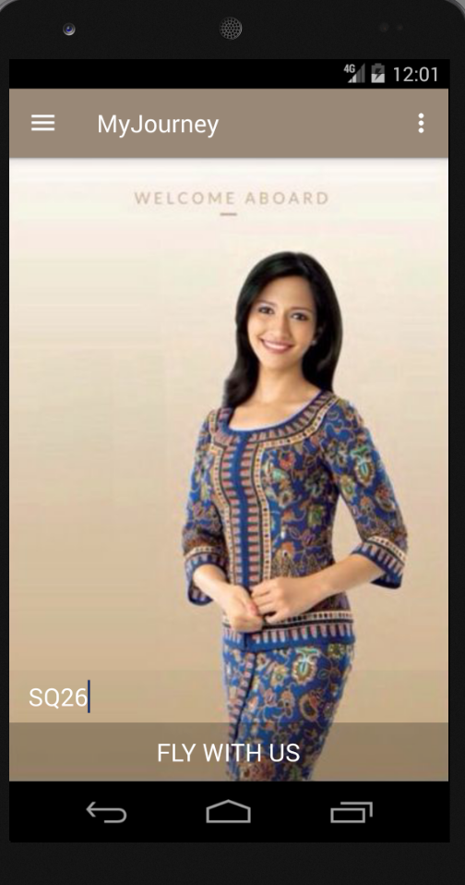
Introducing: My Journey
‘My Journey’ App was design to create a seamless and integrated travel flow for customers, allowing them to easily keep track of their flight information in real-time.
We believe that by providing the right information at the right time, this allows SIA to provide a premium and hassle-free travel experience
Users begin on this home page, by entering their flight number, allowing the app to pull the relevant APIs to create a customised dash-board for them

Slide 9
User Design Principles
Integrated Into SIA Systems
My Journey
Minimum Hiccups,
Maximum
Delights
Clean, Intuitive,
Smart User interface

Slide 10
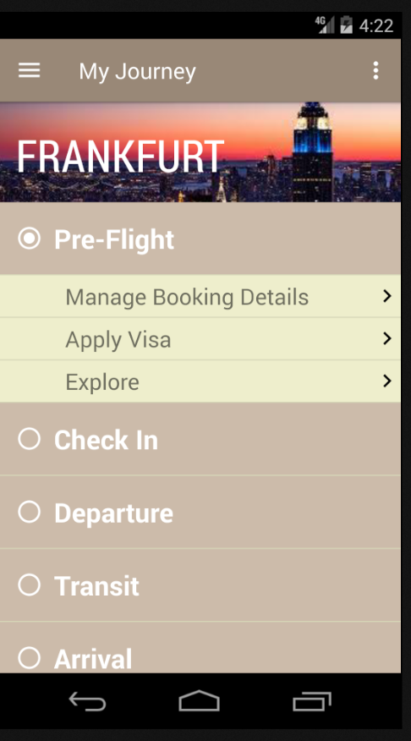
Solution 1: Smart Dash-Board
Smart, clean and intuitive layout
Breaks down trip into check-points for ease of planning and reference
Consolidates all necessary administrative tasks and information into one page
Minimises risk of negative surprises by providing everything customer needs before hand (e.g.links to visa, changing booking details etc.)

Slide 11
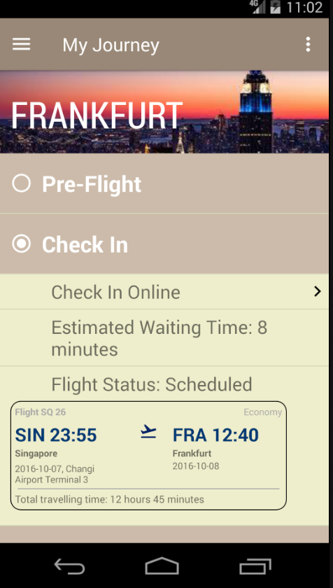
Solution 2: Real-Time Flight Updates
Constant, real-time updates of flight information mean users can better plan their schedules in advance
Allows users to set or automate reminder notifications to alert them of boarding times
Provides a first level of communication about flight disruptions

Slide 12
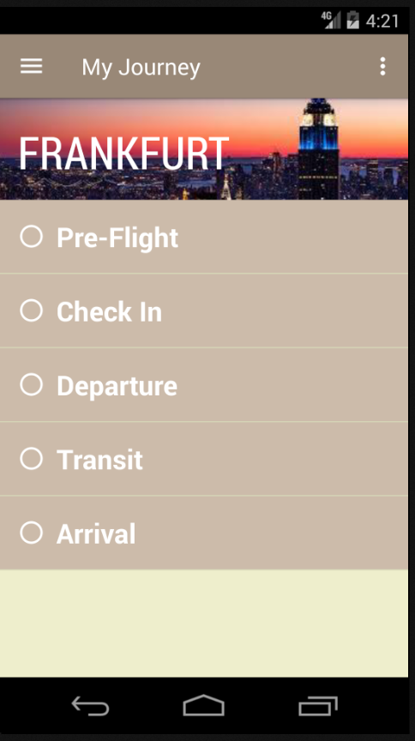
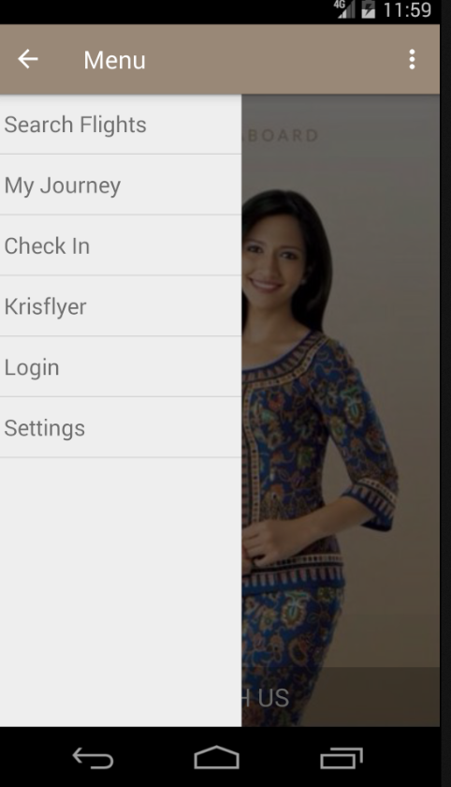
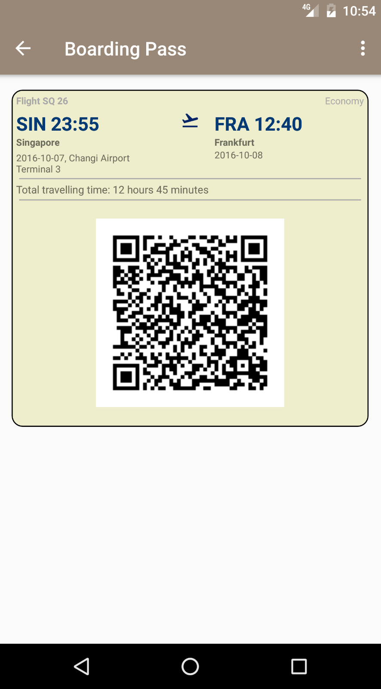

Slide 13
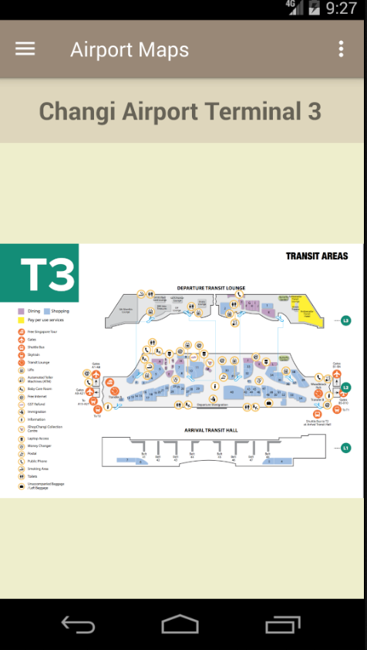
Solution 3: Seamless Airport Navigation
Pre-downloadable Airport Maps help users locate important places in a foreign airport immediately after disembarking and better plan their schedules ahead of time
Pressing the ‘Explore’ button at any Airport shows users all the amenities available (Eat, Shop, Play, Services) and their locations

Slide 14
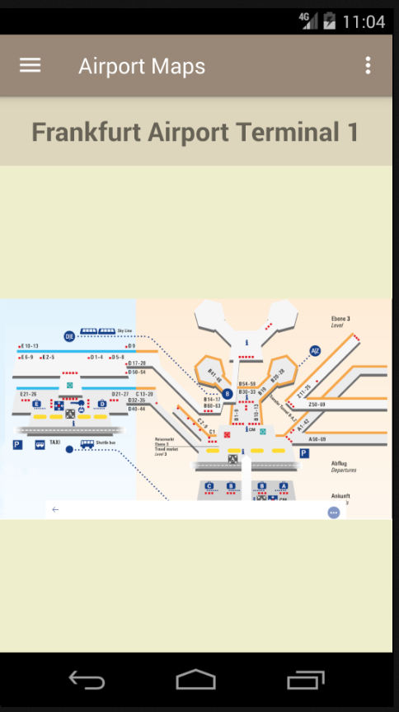
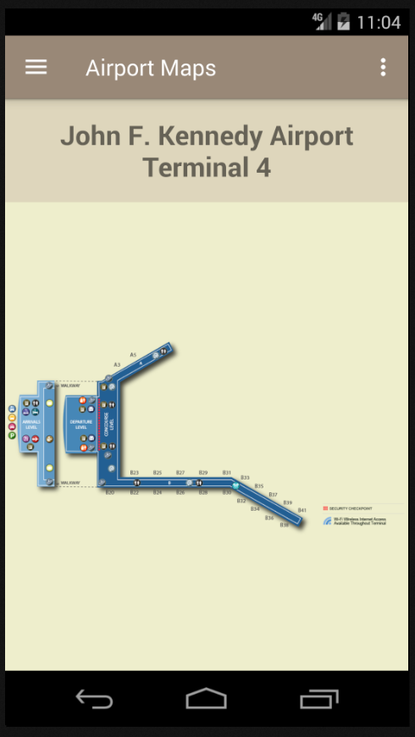
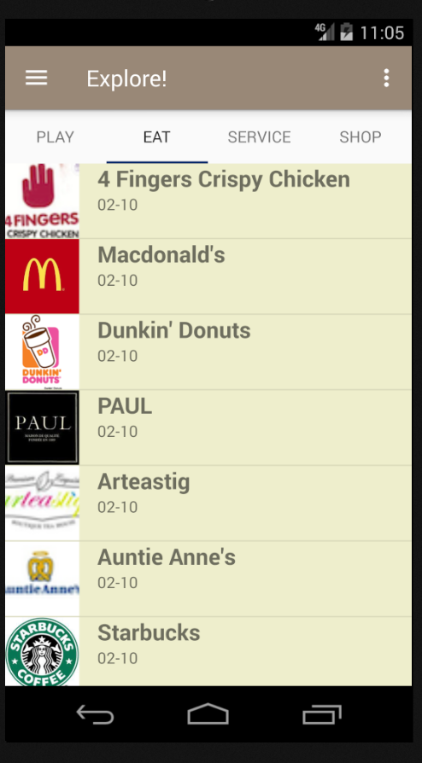

Slide 15
Business Value For SIA
Notes:
Usually, a disruption means having to manually check the board for flight information and seek out customer service for assistance. With ‘My Journey’, the app can be linked up with SIA’s new Sabre crew management system to relay information during disruptions. For example, SIA can consider adding a built in chat feature in order to provide remote, customer service for consumers. This can make a big difference in fast-changing environments where incidents like disruptions or schedule changes require crew to act decisively and efficiently.
Once implemented, Singapore Airlines, SilkAir and Singapore Airlines Cargo will be able to quickly and efficiently manage and track all customer operations, from a single, integrated and real-time web platform, eliminating the work of multiple systems. Using ‘My Journey’, crew managers can plan, schedule, track and manage disruptions to rosters, and impact to crew accommodation. This enables more responsive decision-making and improved productivity and efficiency, including quicker staffing solutions to alleviate flight delays. It will also improve the airlines’ planning capabilities to help meet training and qualification requirements, as mandated by regulatory authorities.
Built around streamlined workflows to make crew management easy and efficient, Crew Manager has an intuitive user interface and includes customizable rules for greater airline control and flexibility. The Crew Manager crew portal and services-based architecture also offer web and mobile browser connectivity for crew members with self-service tools for interactive roster management.

Slide 16
‘My Journey’ provides a seamless travel experience, that not only minimises passenger flight errors, but also delights them with new service experiences and ease of navigation.
This reaffirming SIA’s commitment to customer service and ‘the lengths it goes to’
There are currently very few other airlines which provide digital complementary flight services for their passengers, which means strengthening SIA’s market leadership
Notes:
Usually, a disruption means having to manually check the board for flight information and seek out customer service for assistance. With ‘My Journey’, the app can be linked up with SIA’s new Sabre crew management system to relay information during disruptions. For example, SIA can consider adding a built in chat feature in order to provide remote, customer service for consumers. This can make a big difference in fast-changing environments where incidents like disruptions or schedule changes require crew to act decisively and efficiently.
Once implemented, Singapore Airlines, SilkAir and Singapore Airlines Cargo will be able to quickly and efficiently manage and track all customer operations, from a single, integrated and real-time web platform, eliminating the work of multiple systems. Using ‘My Journey’, crew managers can plan, schedule, track and manage disruptions to rosters, and impact to crew accommodation. This enables more responsive decision-making and improved productivity and efficiency, including quicker staffing solutions to alleviate flight delays. It will also improve the airlines’ planning capabilities to help meet training and qualification requirements, as mandated by regulatory authorities.
Built around streamlined workflows to make crew management easy and efficient, Crew Manager has an intuitive user interface and includes customizable rules for greater airline control and flexibility. The Crew Manager crew portal and services-based architecture also offer web and mobile browser connectivity for crew members with self-service tools for interactive roster management.

Slide 17
‘My Journey’ gives SIA the potential to generate new revenue streams via context-based advertising and new retail partners
In alignment with its portfolio strategy, SIA can transition from owning a group of airfleets, to a complete ecosystem, where it communicates with passengers and provides solutions to their needs in real-time.
One example of doing is by partnering with ‘preferred’ retail outlets and service providers, and feature them on the ‘Explore’ page of the app. The promotions and services featured are highly relevant to the consumer based on their destination and flight information. SIA can then gain commission from the ad revenues.
Notes:
Usually, a disruption means having to manually check the board for flight information and seek out customer service for assistance. With ‘My Journey’, the app can be linked up with SIA’s new Sabre crew management system to relay information during disruptions. For example, SIA can consider adding a built in chat feature in order to provide remote, customer service for consumers. This can make a big difference in fast-changing environments where incidents like disruptions or schedule changes require crew to act decisively and efficiently.
Once implemented, Singapore Airlines, SilkAir and Singapore Airlines Cargo will be able to quickly and efficiently manage and track all customer operations, from a single, integrated and real-time web platform, eliminating the work of multiple systems. Using ‘My Journey’, crew managers can plan, schedule, track and manage disruptions to rosters, and impact to crew accommodation. This enables more responsive decision-making and improved productivity and efficiency, including quicker staffing solutions to alleviate flight delays. It will also improve the airlines’ planning capabilities to help meet training and qualification requirements, as mandated by regulatory authorities.
Built around streamlined workflows to make crew management easy and efficient, Crew Manager has an intuitive user interface and includes customizable rules for greater airline control and flexibility. The Crew Manager crew portal and services-based architecture also offer web and mobile browser connectivity for crew members with self-service tools for interactive roster management.

Slide 18
SIA could Integrate the ‘My Journey’ app with existing customer and crew management systems to further improve dissemination of information during disruption.
For example, instead of relying purely on service crew during disruptions, SIA can easily add in web links, text messaging service, or even video streaming support, to provide remote, yet high quality, real-time, customer service.
This can make a big difference in fast-changing environments where incidents like disruptions or schedule changes require crew to act decisively and efficiently.
Notes:
Usually, a disruption means having to manually check the board for flight information and seek out customer service for assistance. With ‘My Journey’, the app can be linked up with SIA’s new Sabre crew management system to relay information during disruptions. For example, SIA can consider adding a built in chat feature in order to provide remote, customer service for consumers. This can make a big difference in fast-changing environments where incidents like disruptions or schedule changes require crew to act decisively and efficiently.
Once implemented, Singapore Airlines, SilkAir and Singapore Airlines Cargo will be able to quickly and efficiently manage and track all customer operations, from a single, integrated and real-time web platform, eliminating the work of multiple systems. Using ‘My Journey’, crew managers can plan, schedule, track and manage disruptions to rosters, and impact to crew accommodation. This enables more responsive decision-making and improved productivity and efficiency, including quicker staffing solutions to alleviate flight delays. It will also improve the airlines’ planning capabilities to help meet training and qualification requirements, as mandated by regulatory authorities.
Built around streamlined workflows to make crew management easy and efficient, Crew Manager has an intuitive user interface and includes customizable rules for greater airline control and flexibility. The Crew Manager crew portal and services-based architecture also offer web and mobile browser connectivity for crew members with self-service tools for interactive roster management.

Slide 19





MY JOURNEY APP
Thank You!

